Slide 1
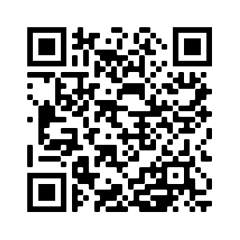
Lent
Lent – 40 days leading up to Easter when we prepare for the Resurrection
Ways to engage:
Fast certain foods meals or abstain from certain activities
Morning prayer – Mon-Thurs; drop-in from 5.30-8.30am
Bible reading plan
Special Services
Ash Wednesday – Mar 2; 7pm
Healing Service - Mar 30; 7pm
Good Friday – Apr 15; 7pm

Slide 2
Mark 1:21-34
Purpose of Mark: to persuade us that Jesus is the Messiah and that we should follow Him
Two elements of Jesus’ identity:
Messiah
Son of God
Two elements of Jesus’ ministry:
Core message – The Kingdom of God is near. Repent and believe the good news.
Core invitation – Come and follow Me

Slide 3
Synagogue

