Slide 1
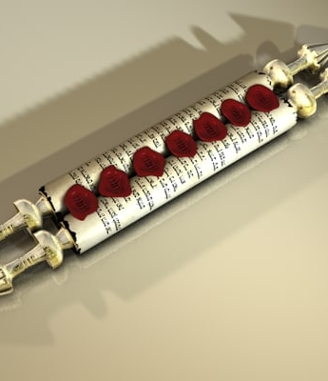
Recap
Father on throne - God is sovereign, in control; working out His plans on the earth
Lion that triumphed is the Lamb that was slain - we overcome (triumph) through death – Jesus’ death on our behalf and our commitment to die to ourselves (surrender) to point of our physical death
Jesus is worthy to open scroll because He died – no one has to endure judgments of Revelation, Jesus’ death saves from the wrath of God

Slide 2
Revelation 6 | Matthew 24.4-14
1st seal /white horse - spread of Gospel | Gospel will preached in whole world
2nd seal /red horse - war | Wars, rumors of wars, nation will rise against nation and kingdom against kingdom
3rd seal/black horse – famine (limited) | There will be famines in various places
4th seal/pale horse – pestilence (limited) | There will be pestilences in various places (Lk 21.11)
5th seal – martyrdom | You will be handed over to be persecuted and put to death
6th seal – Day of the Lord Sun turned black like sackcloth Whole moon turned blood red Stars in the sky fell to earth | Immediately after the distress of those days “‘the sun will be darkened, and the moon will not give its light; the stars will fall from the sky, and the heavenly bodies will be shaken.’
Beginnings of Birth Pains – present realities, ongoing since Acts 2

Slide 3
Revelation 6 | Matthew 24.4-14
6th seal – Day of the wrath of God Sun turned black like sackcloth Whole moon turned blood red Stars in the sky fell to earth | Immediately after the distress of those days “‘the sun will be darkened, and the moon will not give its light; the stars will fall from the sky, and the heavenly bodies will be shaken.’
Day of the Lord – still in the future
Day of the Lord – time in history when God will act decisively to judge the wicked, redeem the righteous, and establish His Kingdom on the earth
Wrath of God – His righteous anger poured out on sin
Romans 5.9: Since we have now been justified by his blood, how much more shall we be saved from God’s wrath through him!
1 Thessalonians 5.9: For God did not appoint us to suffer wrath but to receive salvation through our Lord Jesus Christ.

Slide 4
Keep watch and be ready
Matthew 25.1-4: At that time the kingdom of heaven will be like ten virgins who took their lamps and went out to meet the bridegroom. Five of them were foolish and five were wise. The foolish ones took their lamps but did not take any oil with them. The wise ones, however, took oil in jars along with their lamps.
To be wise = to be prepared to wait, even a long time, for Jesus’ return
We want to have roots that are deep enough to ‘stand firm until the End’

Slide 5
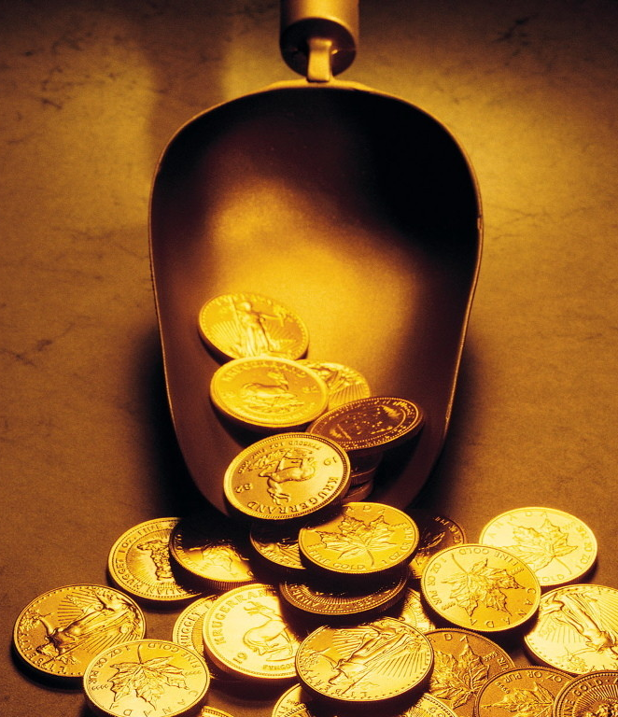
Keep watch and be ready
Matthew 25.19-21: After a long time the master of those servants returned and settled accounts with them. The man who had received five bags of gold brought the other five. ‘Master,’ he said, ‘you entrusted me with five bags of gold. See, I have gained five more.’ “His master replied, ‘Well done, good and faithful servant! You have been faithful with a few things; I will put you in charge of many things. Come and share your master’s happiness!’
To be faithful = to use what God has given us for His purposes
We want to bear fruit ‘that will last’

